Slide 1

Final Software Project
By: Tamara Whitfield
Course: CST499 Capstone to Computer Software Technology
Prof. Joseph Rangitsch
August 23, 2024

Slide 2


Table of contents
SRS Document Summary
UML Design Models
Landing, Login, & Enrollment Pages
SQL Database & Class Registration
PHP Code

Slide 3



SRS DOCUMENT SUMMARY
My SRS document consists of addressing issues concerning to students enrolling in online courses. It outlines the purpose, conventions, audience, scope, external interface requirements, and nonfunctional requirements.

Slide 4
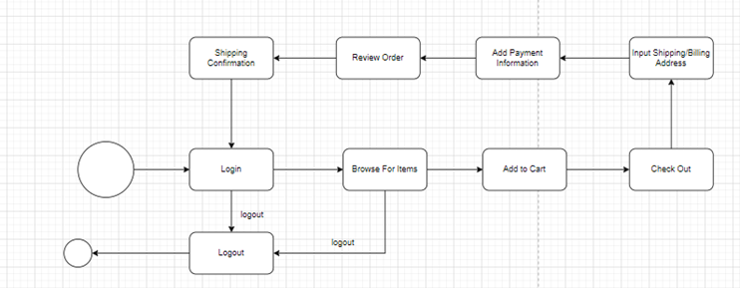
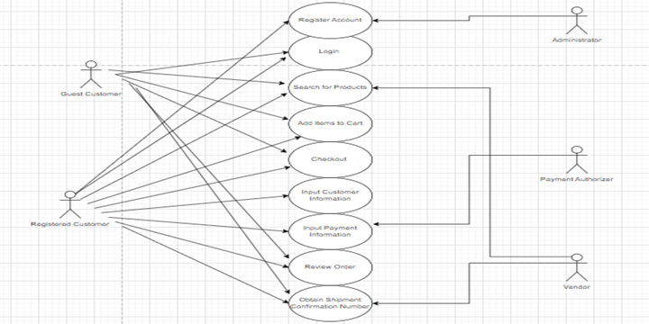
UML DESIGN MODELS
Unified Modeling Language (UML) is a fundamental approach to see the visualized design of the product.
Class Diagram: Represents the classes in the system and their correlation.
Sequence Diagram: Illustrates how objects interact in a scenario.

Slide 5
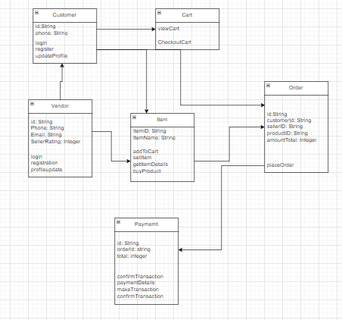
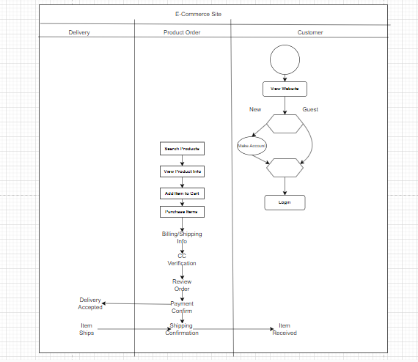
UML Design Models Cont.
Activity Diagram: Behavioral diagram that represents the workflow throughout the system.
State Diagram: Behavioral diagram that describes the states the objects are in and its transitions between them.

Slide 6
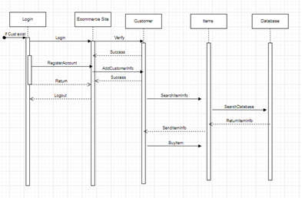
UML Design Model Cont.
Use Case Diagram: Visually represents the functional requirements of the system.

Slide 7


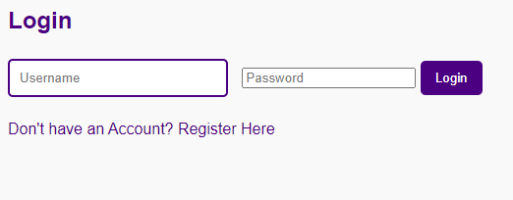
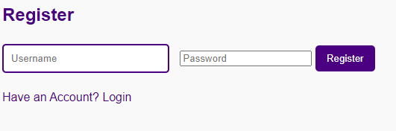
Landing, login, & enrollment pages
The landing page is the first point of contact for the students. They are greeted with “Welcome student!” and have the option to login or register for an account. If they click on “login”, they are met with the login page as they can enter their username and password. If they need to register for an account, they can click “Enroll now” and will be met with the registration page.

Slide 8
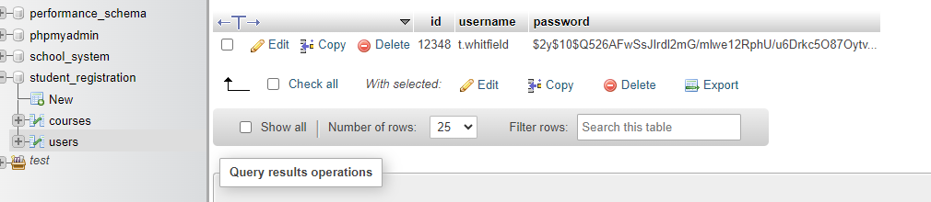
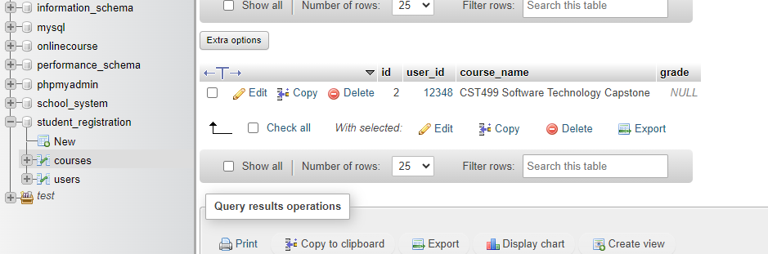
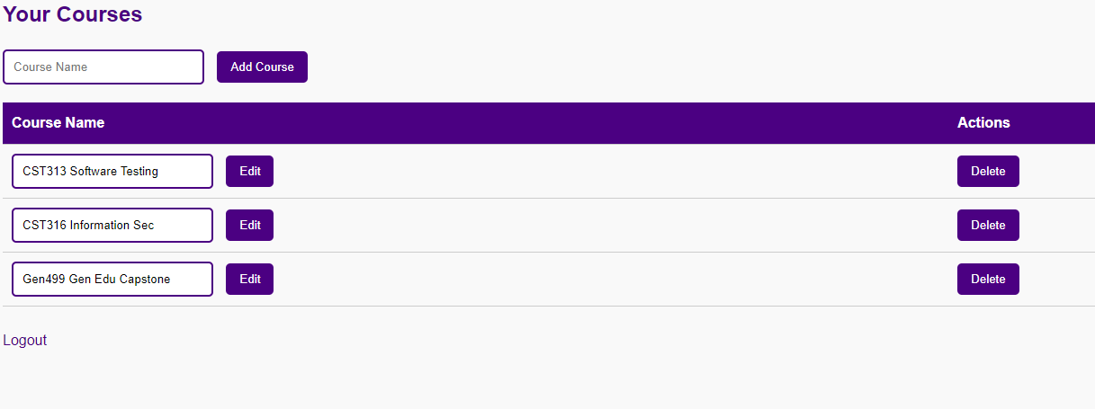
Sql Database & class registration
The SQL Database is a database utilized by SQL for managing data and querying. Tables are organized into columns and rows. Each table represents the entity, while each row corresponds to the record. In my database, I have two tables, courses and users. When a student registers for an account or course, their information is saved to the database.

Slide 9
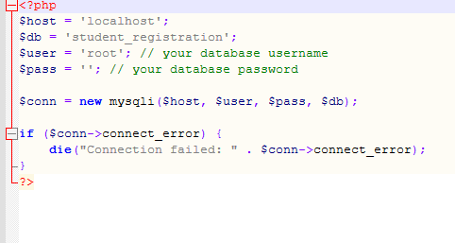
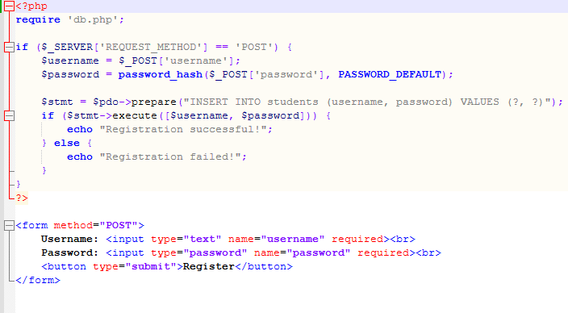
Php code
DB.PHP
Register.PHP
For db.php, the `mysqli` class is created. A connection is established to the student_registration database using the provided credentials. There are four parameters: host, username, password, and database name. The resulting connection object is stored in the variable `$conn`. For register.php, the code gives a simple user registration feature with secure password handling and database interaction.

Slide 10
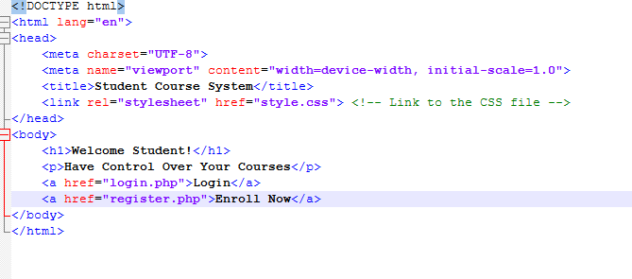
PHP Code CONT.
Landing.php
For landing.php, the code contains data about the application and the call-to-action buttons to direct students to login or register an account.

Slide 11
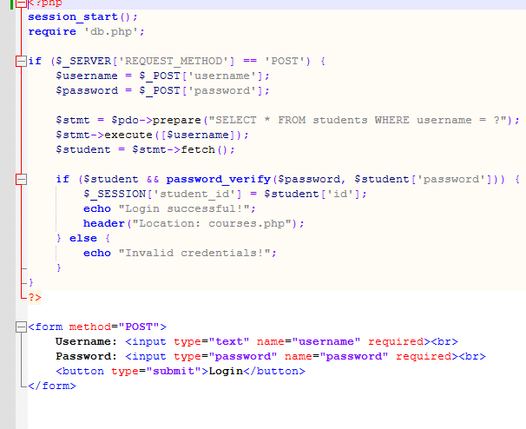
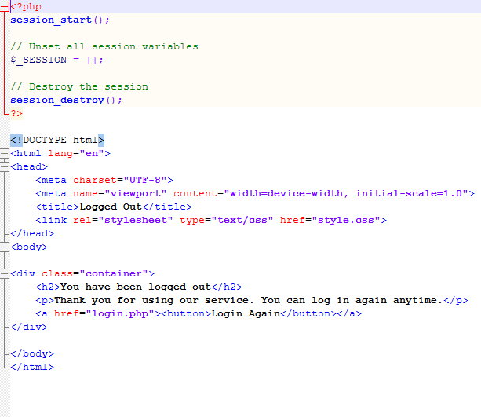
PHP Code Cont.
Login.PHP
Logout.PHP
In login.php, the code displays a simple structure for student authentication with secure password handling and session management. In logout.php, the code used displays a log out students out of a session and inform them that they have been logged out successfully.

Slide 12
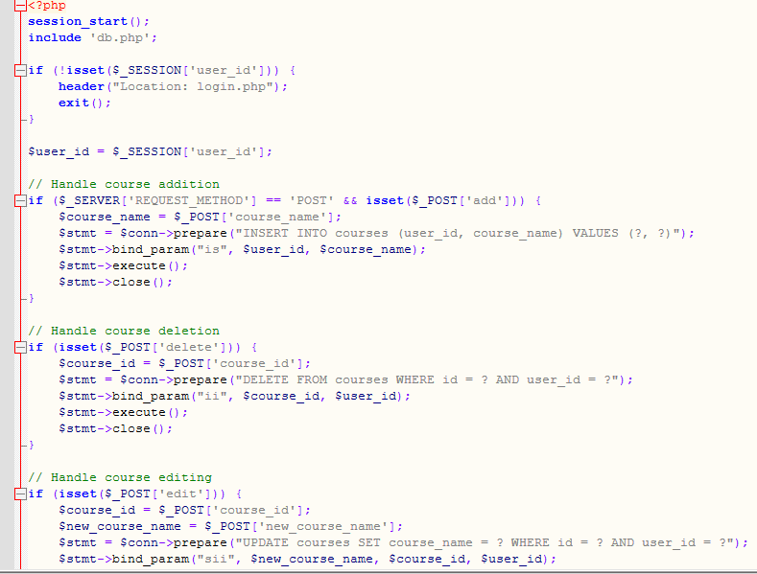
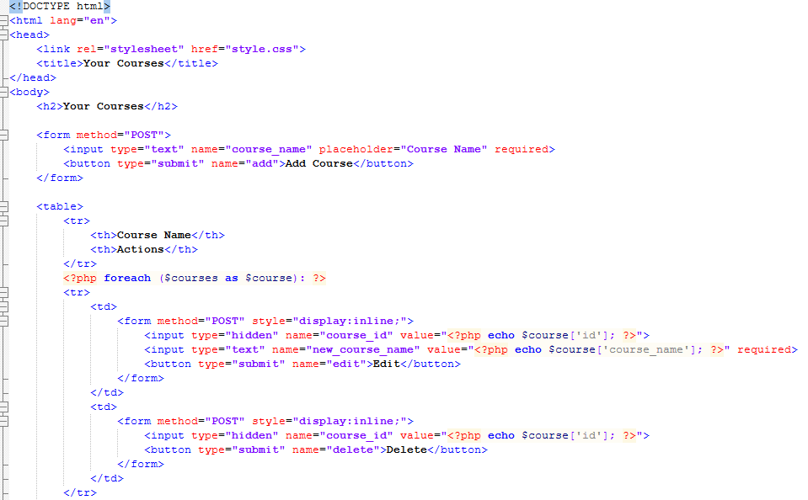
PHP Code Cont.
Courses.PHP
In courses.php, this is the web application script for students to manage their courses. It includes functionalities that will allow them to add, delete, and edit their courses.

Slide 13
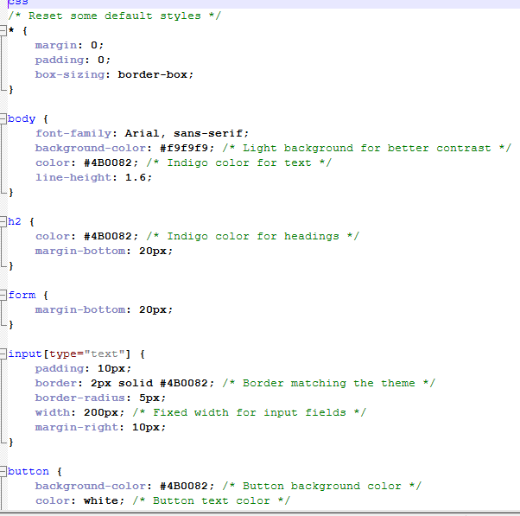
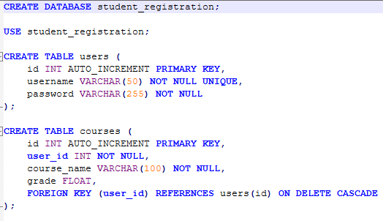
PHP Code Cont.
Style.CSS
Student_registration.sql
I added a style.css stylesheet that gives the webpages a visual style. It defines margins, add body styles, headings, form elements, etc. Overall it gives the webpage a clean, finished design. Student_registration.sql is the database creation of the system. It sets up a foundational structure for managing students and their courses.

Slide 14

Thank you!!!

Slide 15
References
Rempel G. (2015). Defining Standards for Web Page Performance in
Business Applications. https://research.spec.org/icpe_proceedings/2015/proceedings/p245.pdf
Sitelock. (2024). Website Security Definition & How to Keep Your Site Protected. https://www.sitelock.com/blog/what-is-website-security/

